Slide 1

Transfer Learning
Khanh Pham Dinh
Hà Nội, 23/02/2021,

Slide 2
Content
Transfer Learning
Knowledge Distillation
Active Learning
Data Augmentation

Slide 3
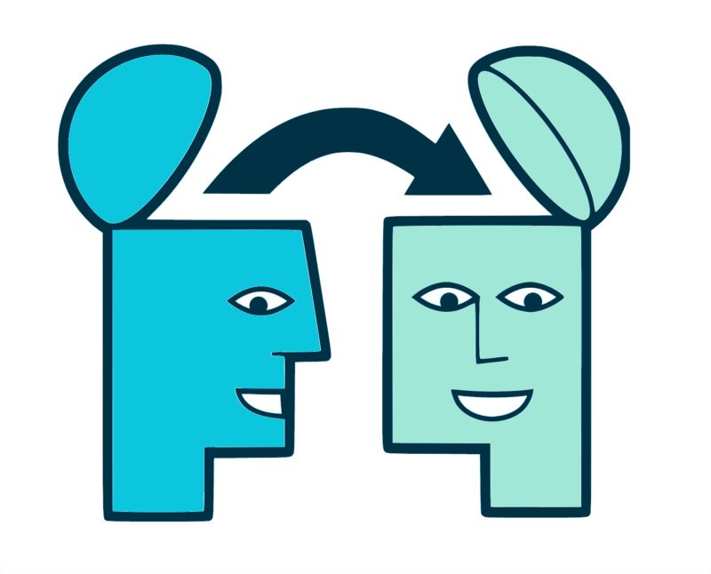
Transfer Learning
Real-life example
People can apply your experience from one domain into another domain
If you know how to drive motorbike, you can drive bicycle
You are good at math, you can apply them in deep learning
You study c++ programming, you can transfer the general knowledge into python
…

Slide 4
Transfer Learning
Why do we need transfer learning
Training model from scratch is time costly and computation expensive.
Have to collect the dataset and label them.
Require high GPU configuration.
The features like edge, texture, shapes,.... which were learned from one model can be useful to recognize another new dataset.
Transfer Learning can increase the model’s accuracy at starting point.

Slide 5
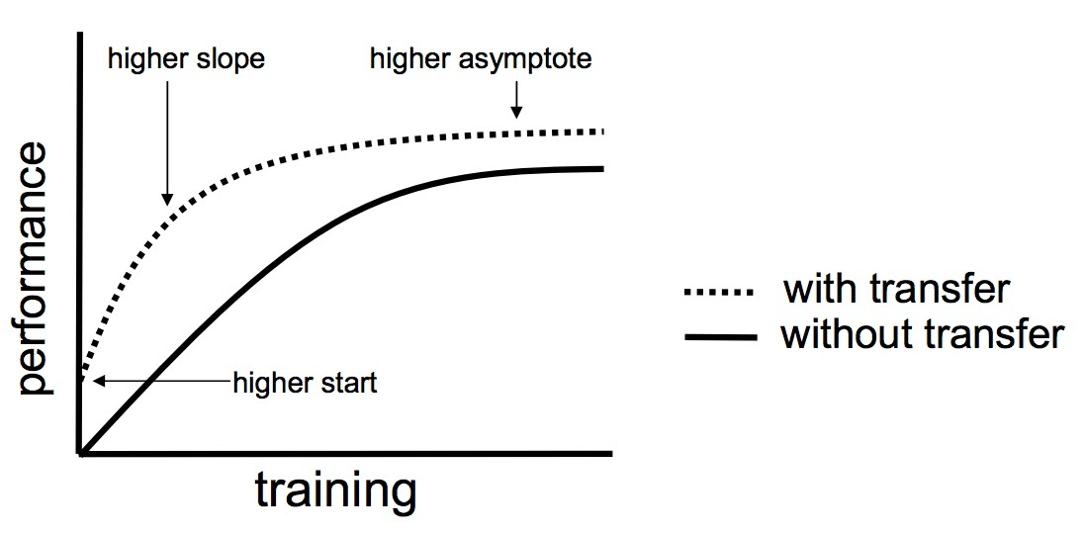
Transfer Learning
Transfer Learning in Neural Network
Transfer learning can bring knowledge from one well pretrained-model to another model under the relevant tasks.
Your model will be better and higher performance if getting off from scratch.

Slide 6
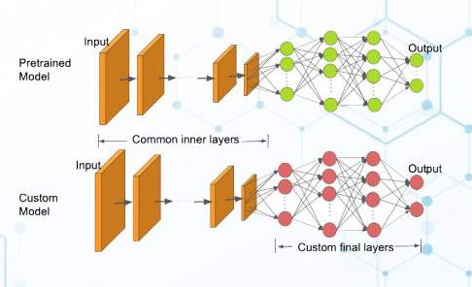
Transfer Learning
What CNN study ?
CNN study low-level features at the beginning layers
The mid-level features study in the middle layers
and the high-level features are in the last layers
⇒ We can extract high-level features at the last in order to create the good features to classification task.

Slide 7
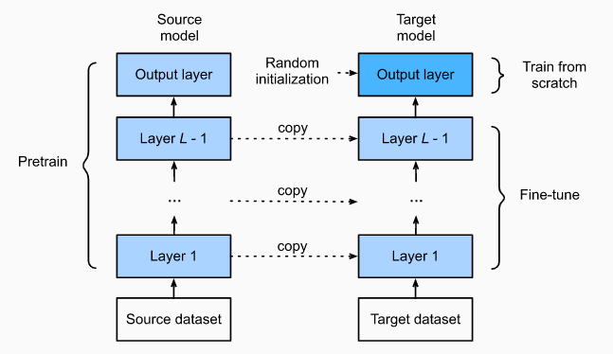
Transfer Learning
Step of Transfer Learning
Pretrain a CNN model. That is source model and source dataset (for example ImageNet).
Create Target model which copy source model's weights of CNN layers. The pretrained model should be trained on source dataset that are relative to target dataset.
Add the output layers on top. The final output layer has number of units equal with number of target dataset’ classes. Randomly initialize the weights of these output layers.
Train the target model on target dataset. The target model should be trained from scratch while other weights of other layers are trained based on finetune CNN model

Slide 8
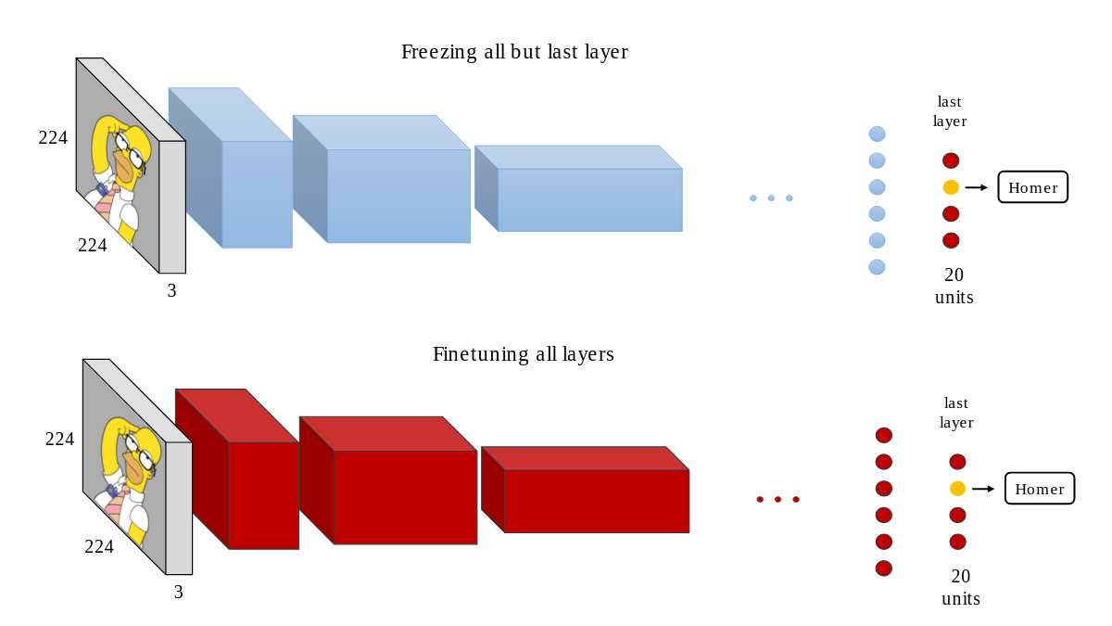
Transfer Learning
Warm up model
Frozen the CNN layers to keep model weights un-change and only train model in the fully connected layers.
Train model on several epochs
That lead model do not corrupt the good features that they studies from pretrained model at the very beginning steps.
start several epochs
Train on other epochs

Slide 9
Transfer Learning
Fine-tune model
After warm-up process, unfreeze the model and re-train on all layers.
start several epochs
Train on other epochs

Slide 10
Transfer Learning
Practice
Practice Transfer Learning - Pytorch
Practice Transfer Learning - Keras

Slide 11
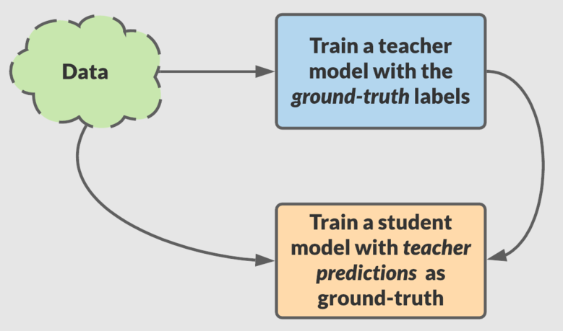
Knowledge distillation
What is knowledge distillation
Invented by Geofrey Hinton in the paper entitled Distilling the Knowledge in a Neural Network - 2015)
Knowledge distillation is the process of transferring knowledge from a large model (teachers) to a smaller one (student)
teacher model have higher capacity knowledge than small model
student model is less expensive and can be deployed on less powerful hardware
used in several applications of machine learning such as object detection,acoustic models,and natural language processing

Slide 12
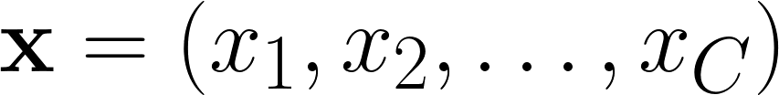
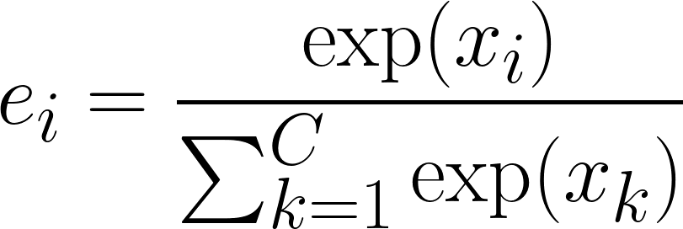
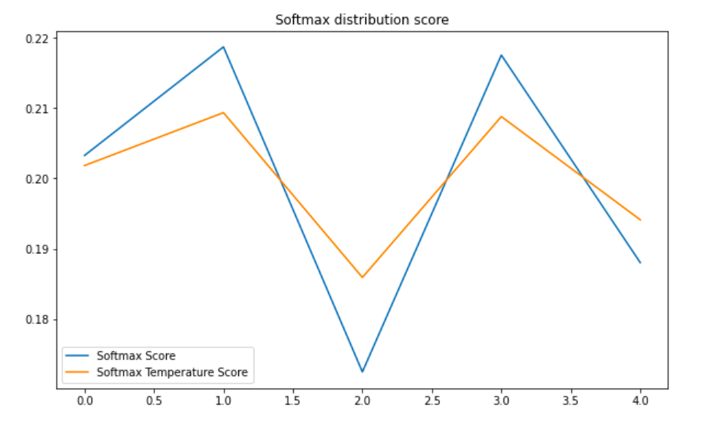
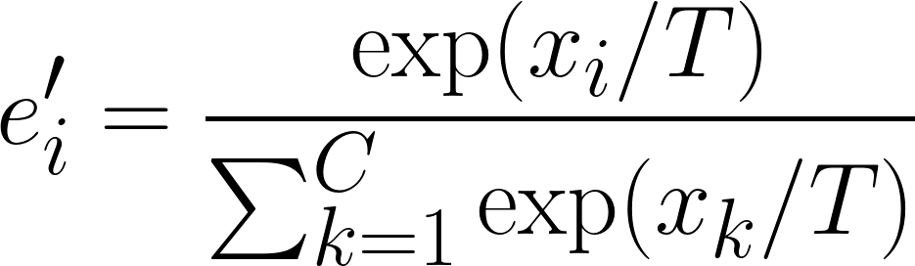
Knowledge distillation
Temperature scale
Efficient way to increase uncertainty of given probability distribution
From input calculate the probability distribution
Smooth the output distribution by formulation
Temperature Scale

Slide 13
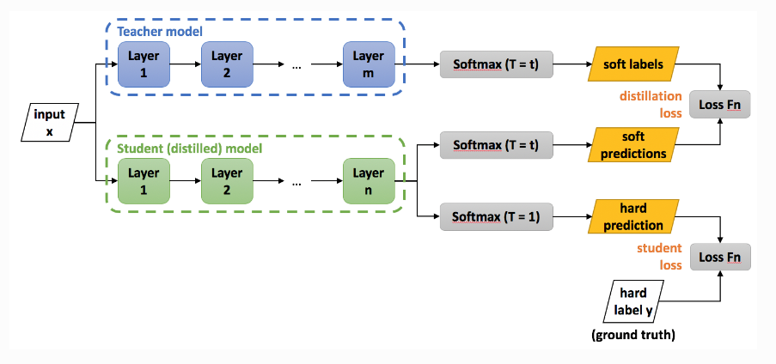
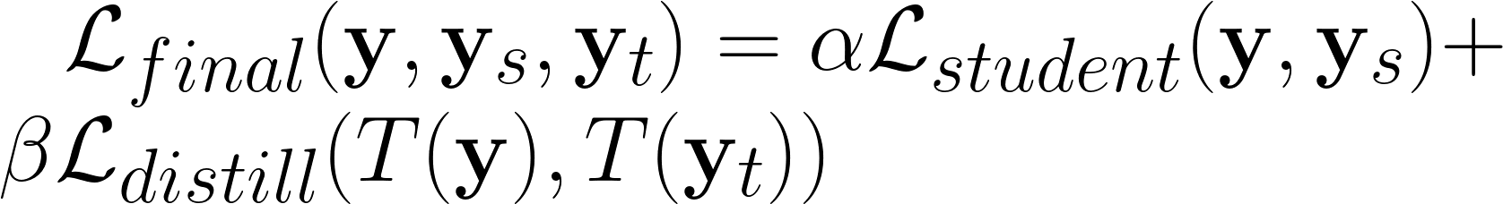
Knowledge distillation
Concept of knowledge distillation
If two large and small models were trained on the same dataset, the large model will have higher capacity to learn knowledge representation.
The large model represents knowledge through the distribution of values among the outputs which called as the soft label.
Use soft label to guide the the student model studying
Optimizing to match the logit of student output to the logit of soft label.
Can combine between soft label with hard label (ground truth of dataset).

Slide 14
Knowledge Distillation
Knowledge Distillation practice
Practice Knowledge Distillation

Slide 15

Active Learning
Unlabeled Data
Intelligent sampling unlabelled data
Choose the most informative observations to train model

Slide 16
Active Learning
Unlabeled Data
Intelligent sampling unlabelled data
Most informative to model training
Very helpful in situation:
Constrain about data budget: Can afford labeling a few points.
Imbalanced dataset: Select rare classes to label.
Target metrics: When baseline sampling strategy does not improve selected metrics.

Slide 17
Active Learning
Select the uncertainty points.
Uncertainty Sampling
Intelligent
select
Active Learning
Select the main points that shape the pattern of clusters.
Diversity Sampling

Slide 18




Active Learning Cycle
Unlabeled Data
Intelligent sampling unlabelled data
Active Learning Sampler
ML model
Human Annotator
Labeled Data

Slide 19
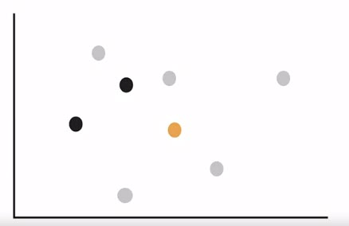

Margin Sampling

Slide 20
Margin Sampling
decision boundary

Slide 21
Margin Sampling
decision boundary
selected the most
uncertain point

Slide 22
Margin Sampling
decision boundary
new
boundary
most uncertain point

Slide 23
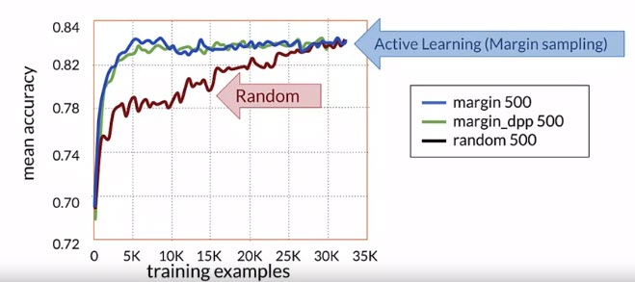
Experiment results on different sampling techniques

Slide 24
Active Learning sampling techniques
Margin sampling: Select the most uncertain point.
Cluster based sampling: Using unsupervised algorithms to cluster and sample from well-formed cluster to cover entire space.
Query by committee sampling: Voting the points have most disagreement from ensemble models.
Region based sampling: Run active learning algorithms on different partitions of the space.

Slide 25
Active Learning
Practice
Practice active learning

Slide 26
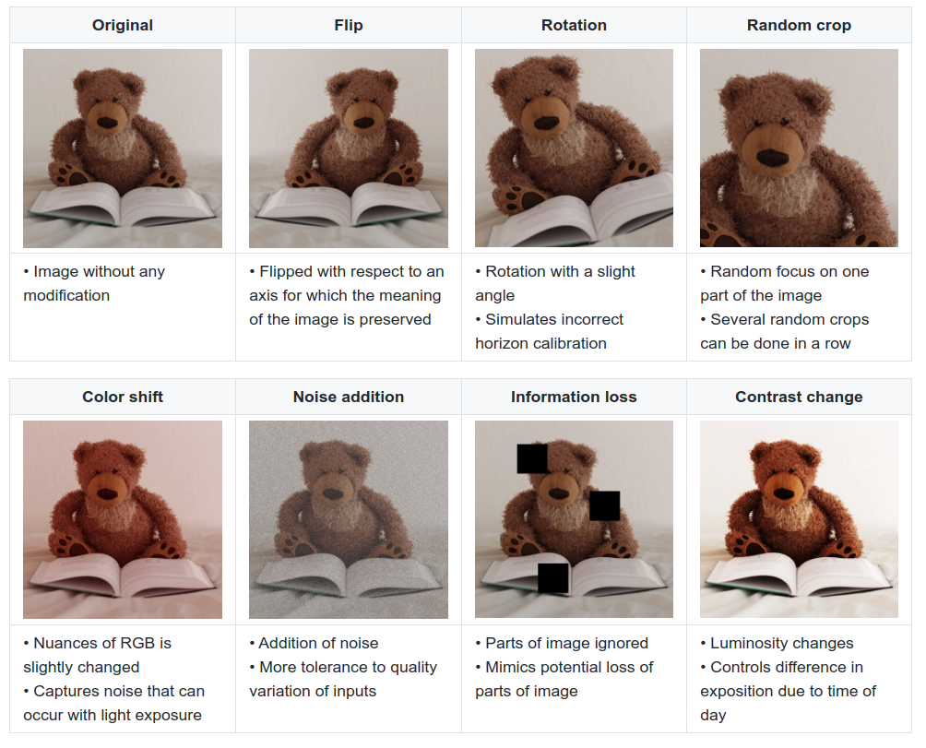
Data Augmentation
Change image content:
Rotation
Random crop
Noise addition
Information loss
Change color:
Color shift
Contrast change
Label smoothing:
Cutmix
Mixup
Package:
Albumentation
Torchvision.Transform
Data Augmentation

Slide 27
Select Final Project
Select topic: before 15/3
Team size: 2 people
Data preparation
Model training
Experiment
Present result

